Slide 1
Software Engineering
Chapter 5
Requirements Engineering – Analysis
Learning Outcomes
Know how to take use cases towards a design
Learn how to use sequence diagrams to capture behaviour
Know how to develop an initial class diagram
Text: Priestley Chapter 5

Slide 2
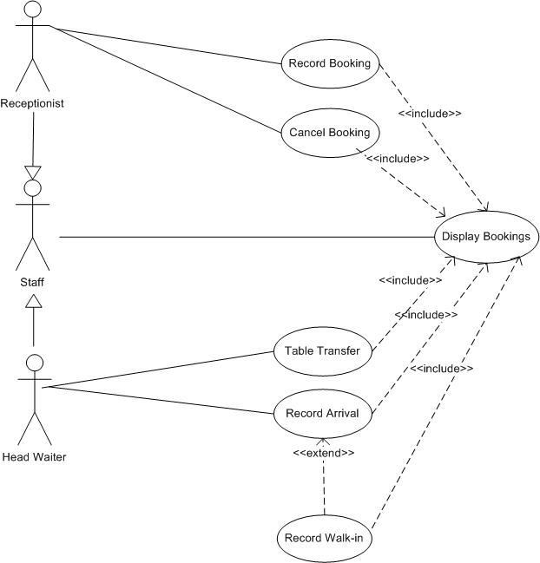
Restaurant Use Case - final

Slide 3
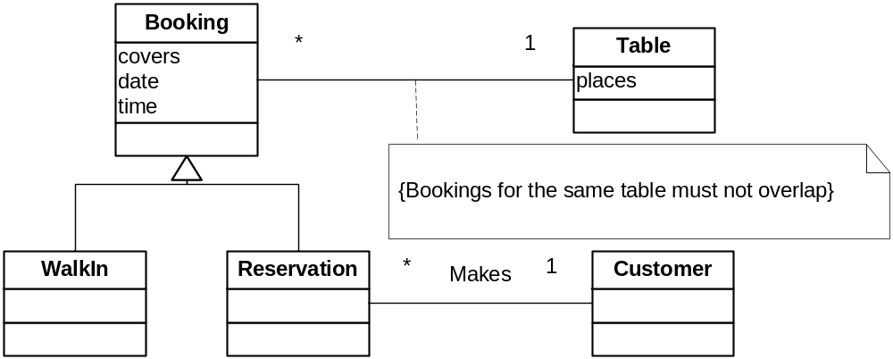
Restaurant Domain Model

Slide 4
What is analysis?
Use Cases
?
Text
Objects
Requirements are documented as use cases = text
Use cases describe external behaviour
Give no details of the internal structure or interactions
Need to move to a description in terms of objects
In the implemented system it will be objects that interact to achieve the behaviour described in the use cases.

Slide 5
Use Case Realisation
Realisation = Developing a high-level interaction for each use case
Uses interaction diagrams
  Sequence diagrams
  Collaboration Diagrams (Communication Diagrams – UML)
But isn’t this design?
  Yes – there is no clear distinction – but here we are focused on the requirements. We could be very detailed and end up with a full design
  Later – focus on implementation, then it is design

Slide 6
Object Design
Domain model (presented previously)
  This is a starting point not the final class model
  One of the quoted advantages of OO is the natural translation from domain to code
    Domain model likely to form the basis of the final class diagram
      Not complete – there will be more classes, more attributes
      No operations – or just the inclusion of real-world actions
Object Responsibilities
  Objects should be characterised by their responsibilities
    Maintain data – held in objects as attributes
    Support some processing
  An object’s responsibilities should all be closely related (cohesion)
  Some people use Class Responsibility Collaboration (CRC) cards as they identify objects

Slide 7
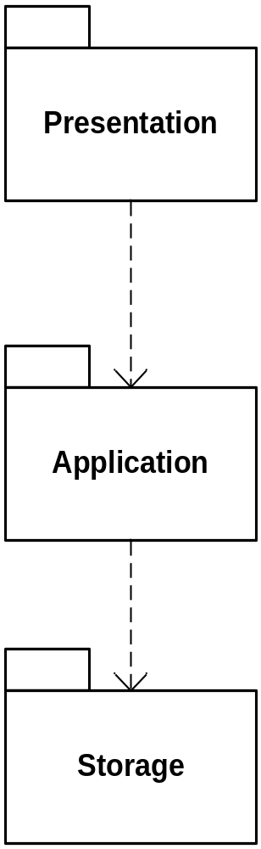
Software Architecture Choice
The division of system into subsystems
Layered Architecture
  Allocate responsibilities to different subsystems
  Define clean and simple interfaces between layers
  Common to use a Presentation – Application – Storage pattern
    Presentation = classes relating to the user interface
    Application = classes relating to business logic
    Storage = classes relating to managing data (e.g. database)
UML symbol for package

Slide 8
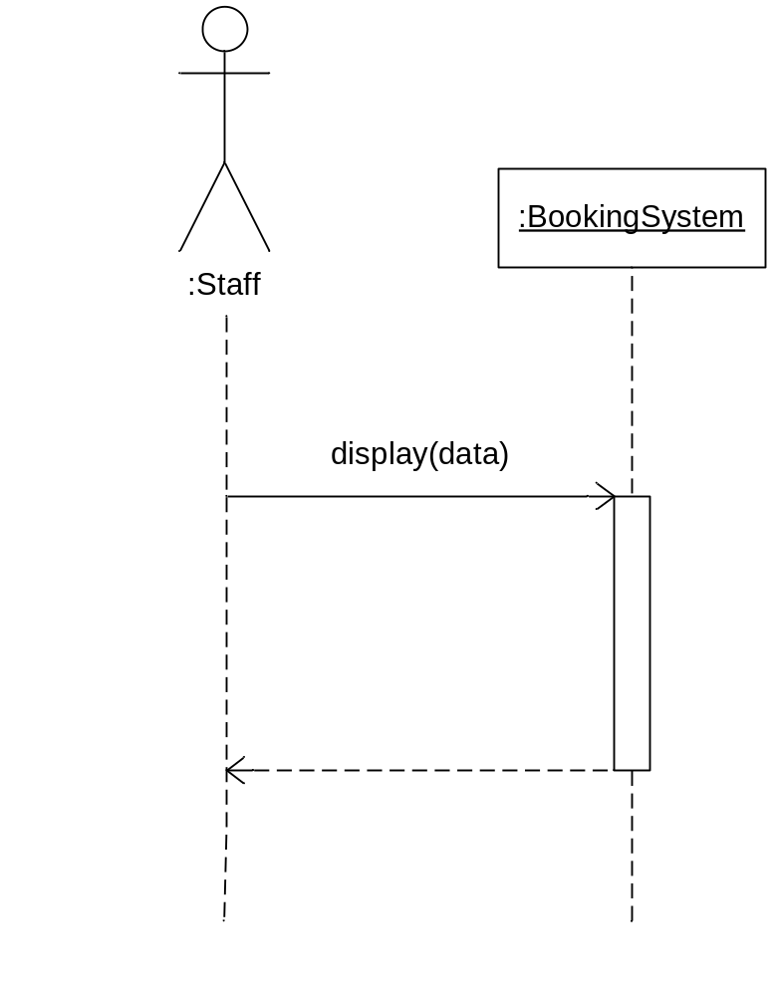
Use case realisation: sequence diagrams
System messages e.g. “Display Bookings”
What object should receive the message to display booking?
  There isn’t one in the domain model
  Add a “Control” object for the use case
  Need to add a control object for each use case
  Or one for the whole system (OK for a small system)
Objects (NOT CLASSES)
along the top, hence the “:”
method in receiving object
display(date)
message
timeline
activation
(period of interaction)
control return

Slide 9
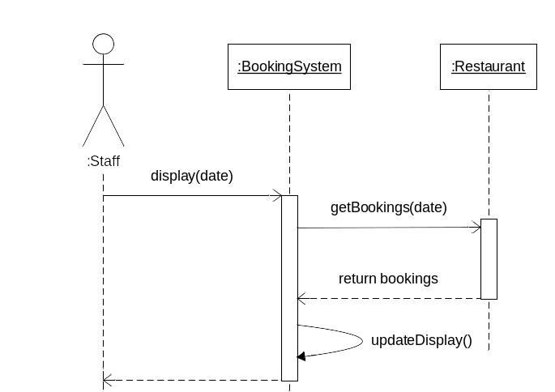
Refining the sequence diagram
In order to display we must first get the data
Need to know which object has the responsibility for the (set of) booking data
  Add Restaurant class
  Can iterate though the bookings to get their details as required

Slide 10
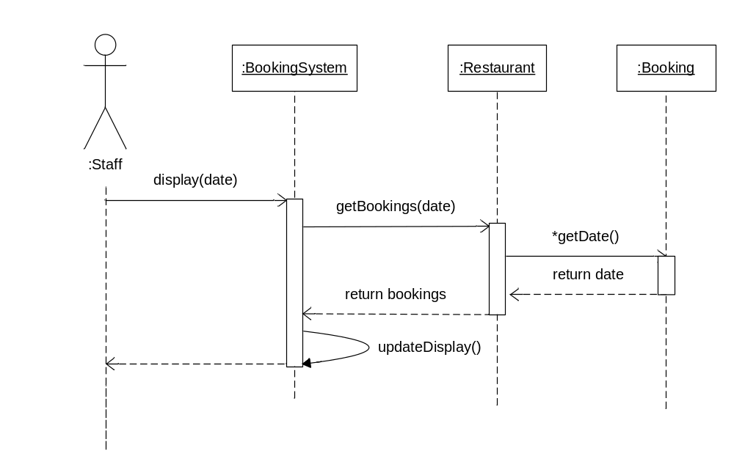
Display bookings: basic course of events
[The asterisk indicates that the operation is performed repeatedly]

Slide 11
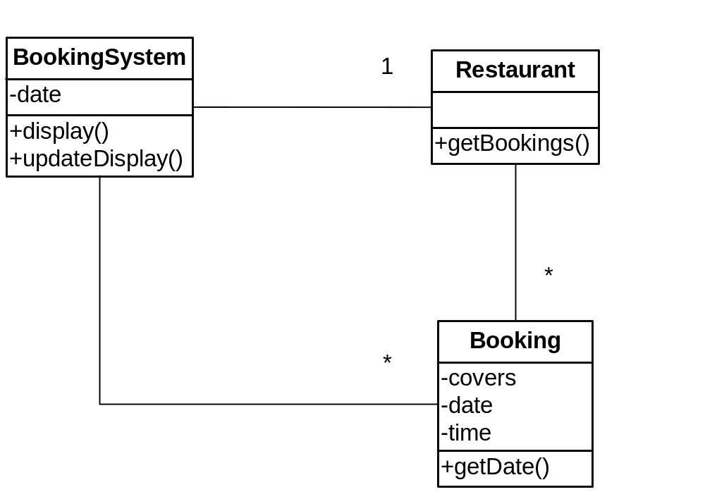
Updating the domain model
Methods represent all the messages in the sequence diagram

Slide 12
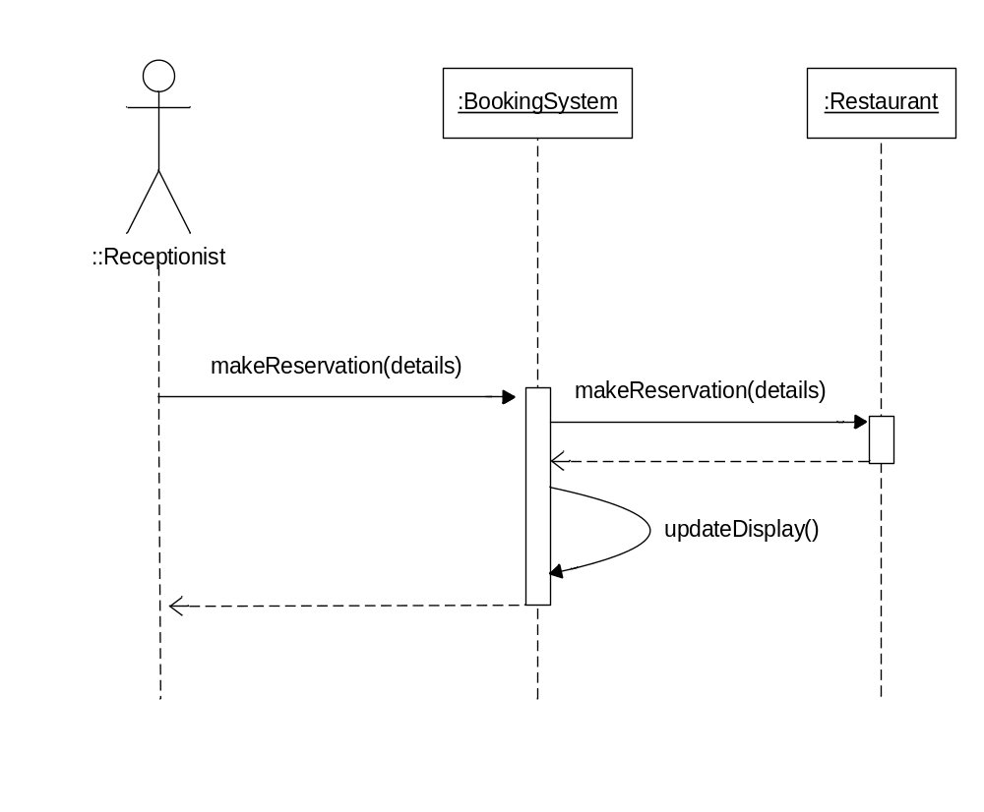
Recording a new reservation
Initial sequence diagram for recording new reservations – but we need more detail!

Slide 13
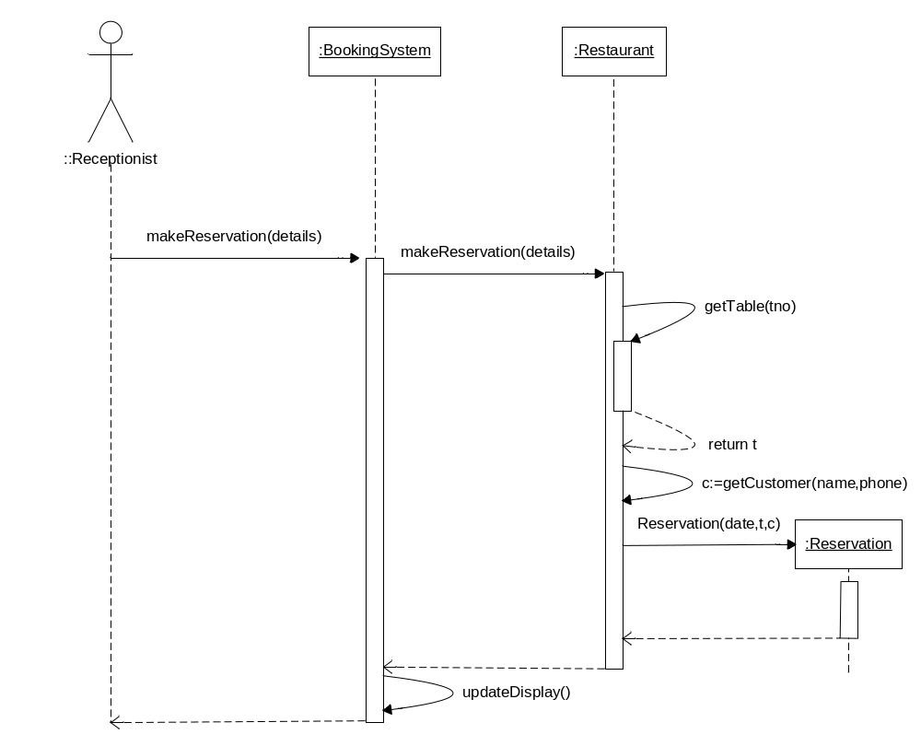
Recording a new reservation – creating a new reservation object
Restaurant has responsibility for assigning customers to tables
Method* to return the table object (t)
[object not shown in the diagram]
that corresponds to a
table number (tno) contained in the reservation ‘details’
Method* to return the
customer object (c)
[object not shown in the diagram]
that corresponds to a name
and phone no. contained in the reservation ‘details’
Create a new Reservation
This is down here because it doesn’t exist at the start
*Note the alternative ways of showing an object (Restaurant) calling its own methods

Slide 14
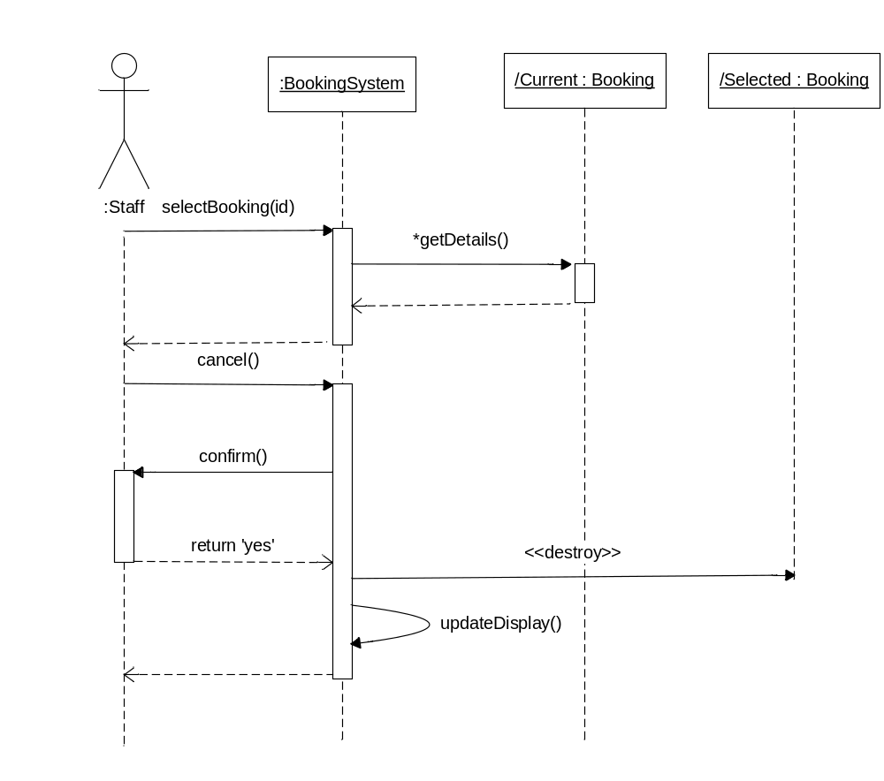
Cancelling a booking
User selects the required booking to cancel
BookingSystem object iterates through the bookings to get the required one
e.g. user clicks button to cancel – calls cancel()
confirm
<<destroy>> is a stereotype = end this lifeline – in due course this will require some tidying up of the database!
Note: as a simplification the Restaurant instance has been omitted from this sequence diagram. In keeping with the previous diagram, and in a full implementation, it would serve as an intermediary between the BookingSystem and the Bookings.

Slide 15
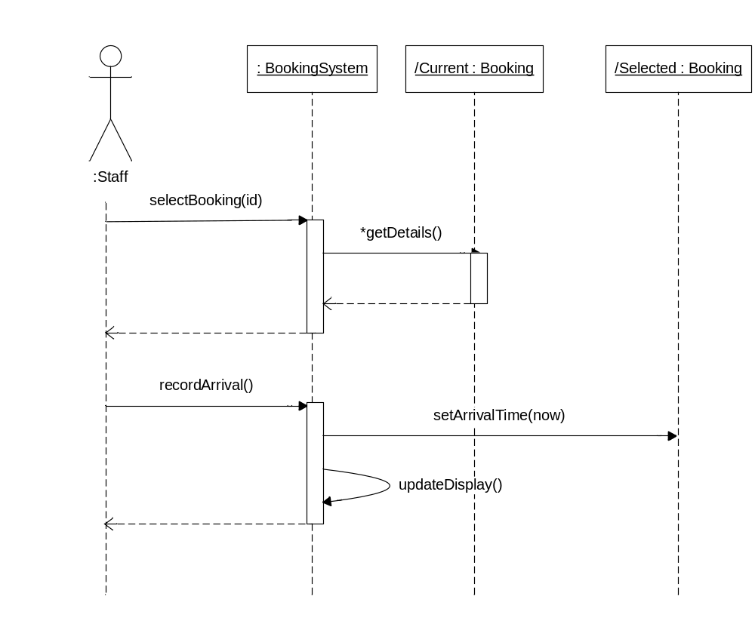
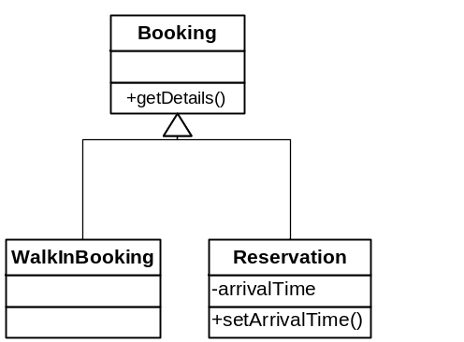
Record arrival
What about Walk-ins?
  Move meaningful setArrivalTime to
  Reservation!
Booking
+getDetails()
+getDate()
+setArrivalTime()
Note: as in the previous slide, the Restaurant instance has been omitted.

Slide 16
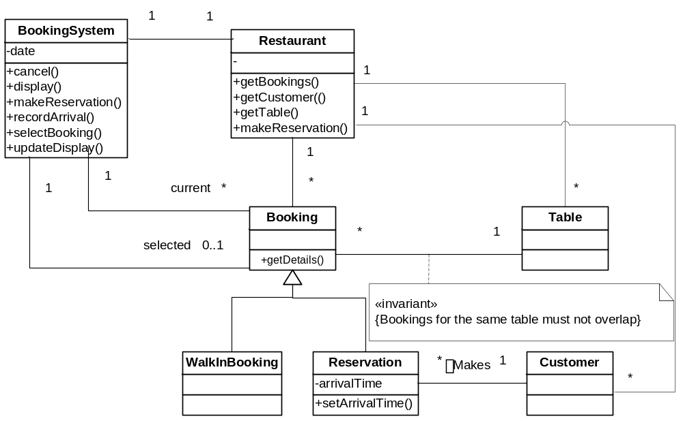
Completing the analysis model
Booking
+getDetails()
+getDate()
+setArrivalTime()
+getDetails()
+getDate()

Slide 17
Software Engineering
Chapter 5
Requirements Engineering – Analysis
Learning Outcomes
Know how to take use cases towards a design
Learn how to use sequence diagrams to capture behaviour
Know how to develop an initial class diagram
Text: Priestley Chapter 5

